Slide 1
Food Delivery Service Database
Eimear Quinlan
Liam Walsh

Slide 2
Why We Chose Food Delivery
Industry which relies on accurate data retrieval to ensure success
Each database entry has lots of data associated with it
Especially applicable in the current day

Slide 3
Business Rules
Each driver can deliver to many customers, and each customer can receive items from multiple drivers.
Each customer can place multiple orders, but each order is only for one customer.

Slide 4
Business Rules cont.
Each order can have items from only one restaurant, but each restaurant can process multiple orders.
Each driver can get an order from multiple restaurants, and each restaurant can give orders to multiple drivers.

Slide 5
Schema Breakdown
Customer
Primary Key: CustomerID
Fname, Lname, Phone, Address
Driver
Primary Key: DriverID
Fname, Lname, Phone, LicenseNum
Restaurant
Primary key: RestaurantID
Street, Town, State, FoodType, Name

Slide 6
Schema Breakdown cont.
Car
Primary Key: CarDriverID, CarID
Plate, Type
FoodOrder
Primary Key: OrderCustomerID, OrderRestaurantID, OrderDriverID, OrderID
OrderTime, Items, Price
Payment
Primary key: PaymentCustomerID
Bank, CardNum
Foreign Key: CarDriverID
Foreign Key: OrderCustomerID, OrderRestaurantID, OrderDriverID
Foreign Key: PaymentCustomerID

Slide 7
Schema Breakdown cont.
Tip, TimeEst
Foreign Key: DeliverCustomerID, DeliverDriverID
Primary Key: DeliverCustomerID, DeliverDriverID
Delivers_To

Slide 8
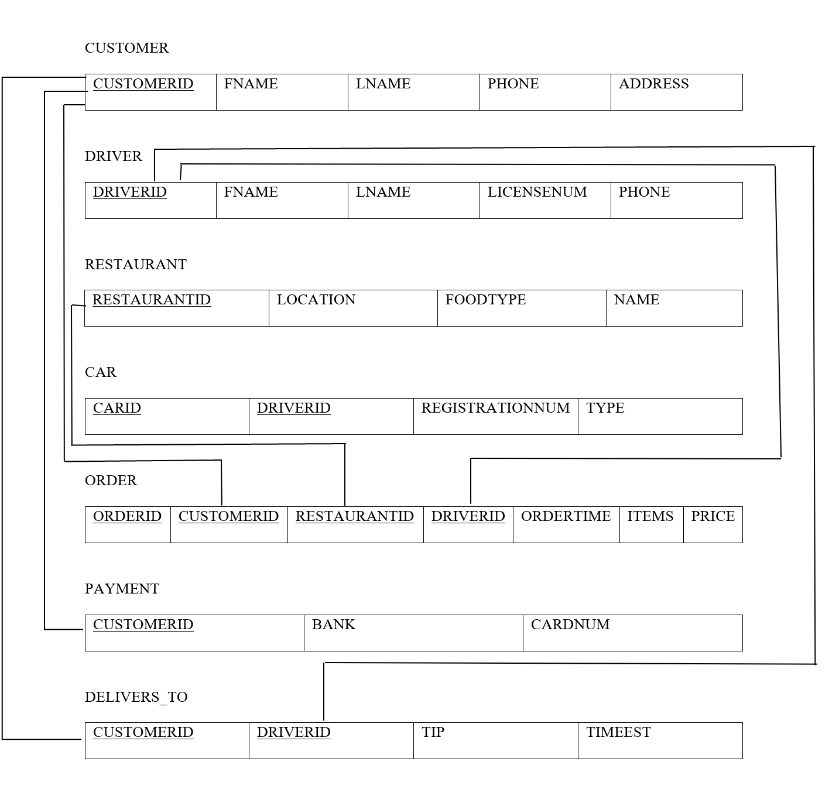
Schema

Slide 9
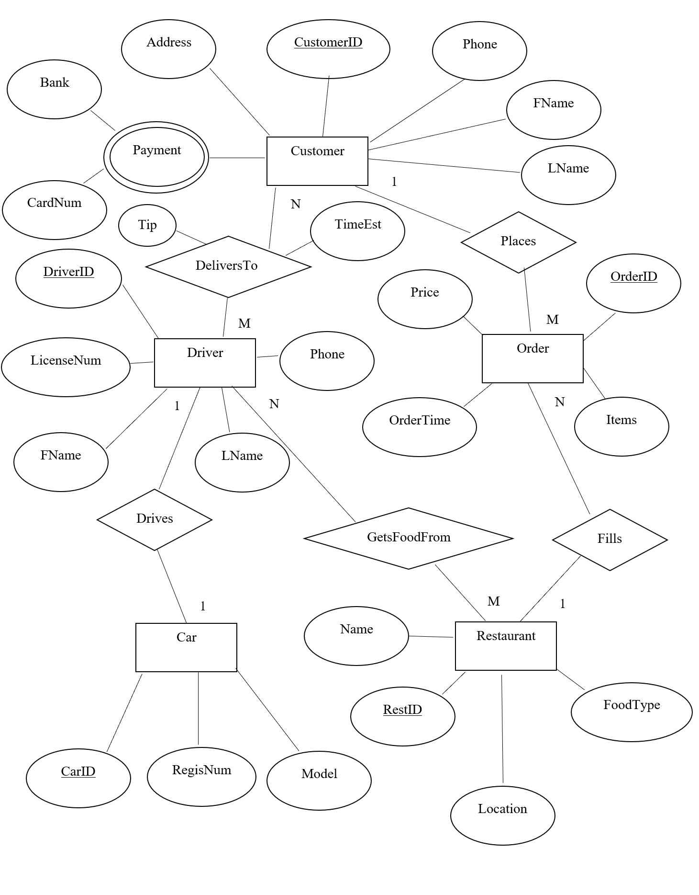
ER Diagram

Slide 10
Data Utilized
Real restaurant data from around Villanova
Names, addresses, and food types are taken from restaurants within delivery distance of Villanova
Created but true to reality data for all other sections
Proper length of license number, license plate, card number, etc. to make data like real life

Slide 11
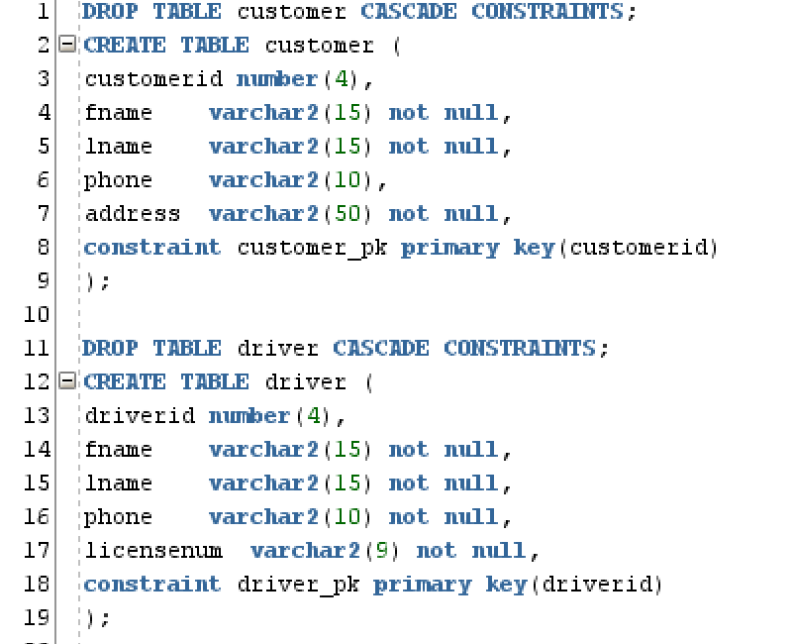
Schema Code
First Drop Table
Then Create Table
Define attributes and primary key

Slide 12
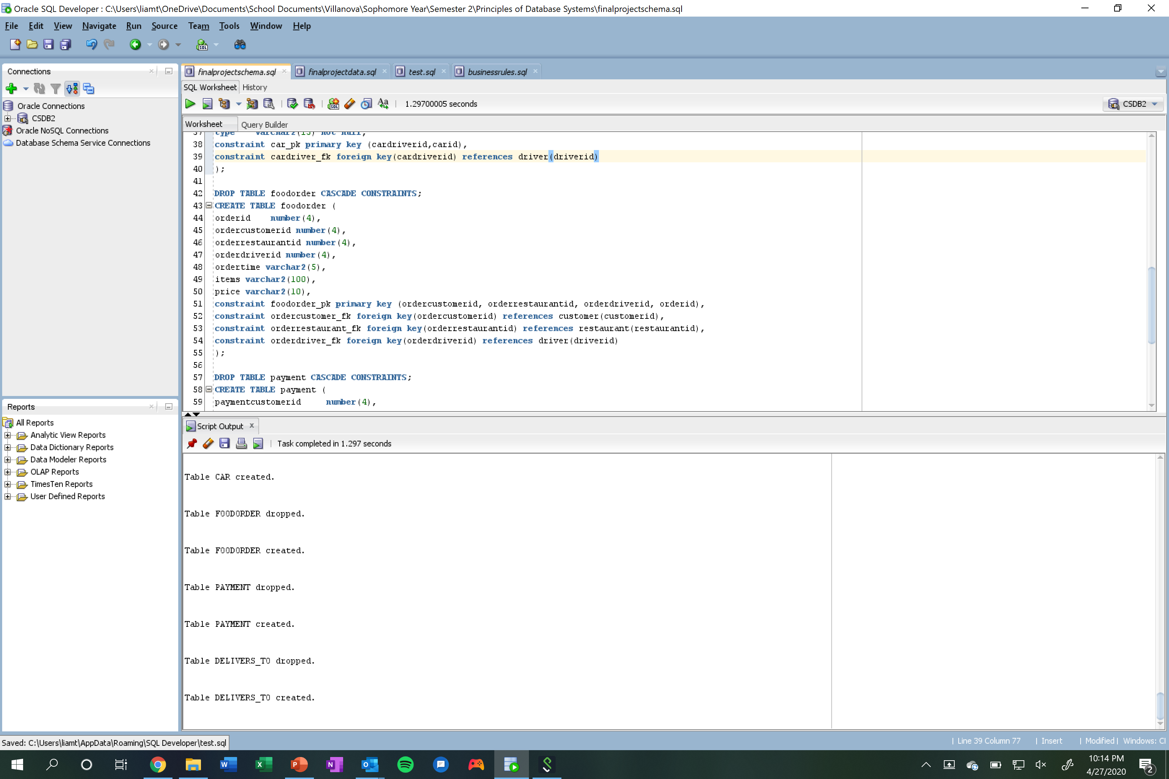
Schema Code cont.
Foreign Key defined as constraint
References primary key of another table

Slide 13
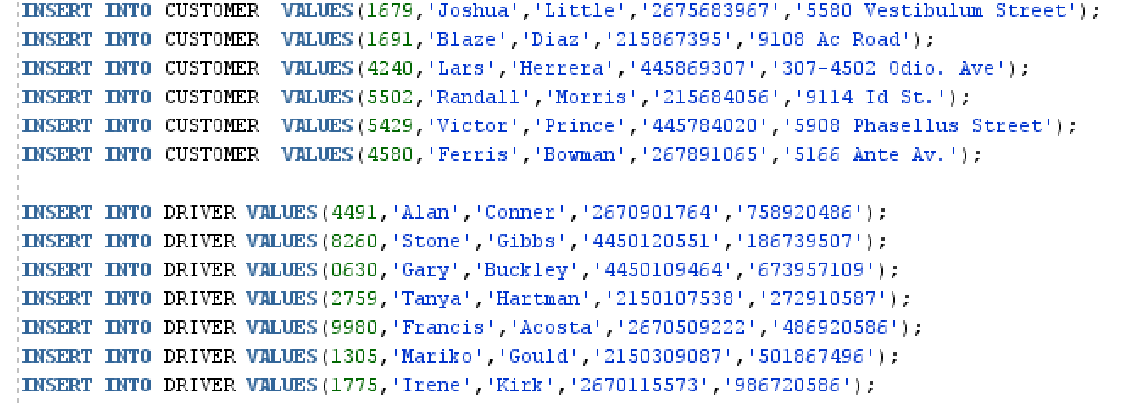
Data Addition
Primary key and other attributes defined

Slide 14
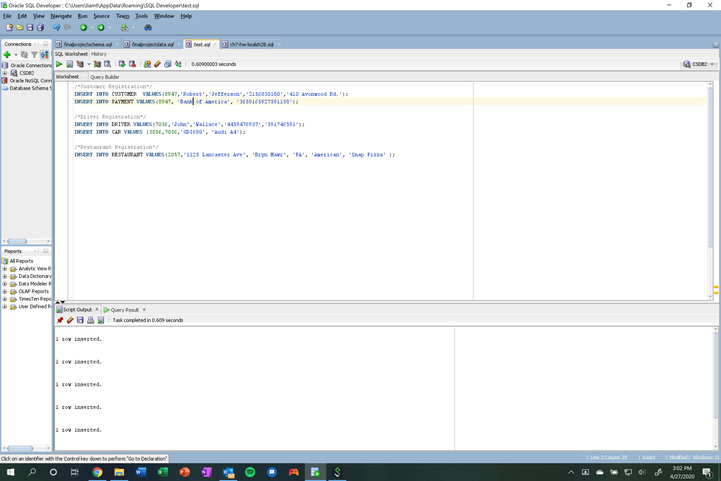
Sample Queries
Example of a typical food order and corresponding database entries
First add a new customer with payment information, then a new driver with a car, and finally a restaurant

Slide 15
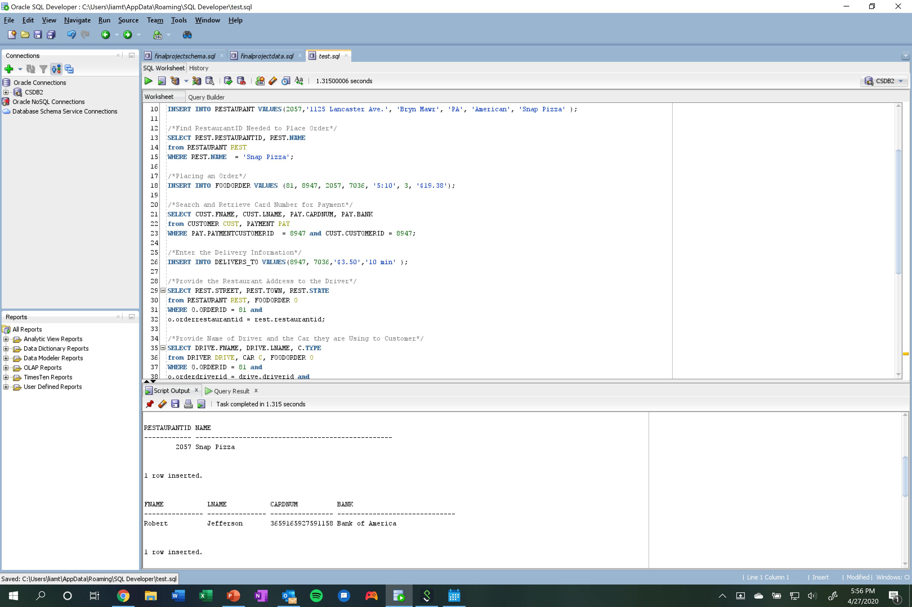
Sample Queries cont.
Find the RestaurantID given the name of restaurant
Create the food order
Find customer payment information
Create a delivers_to entry

Slide 16
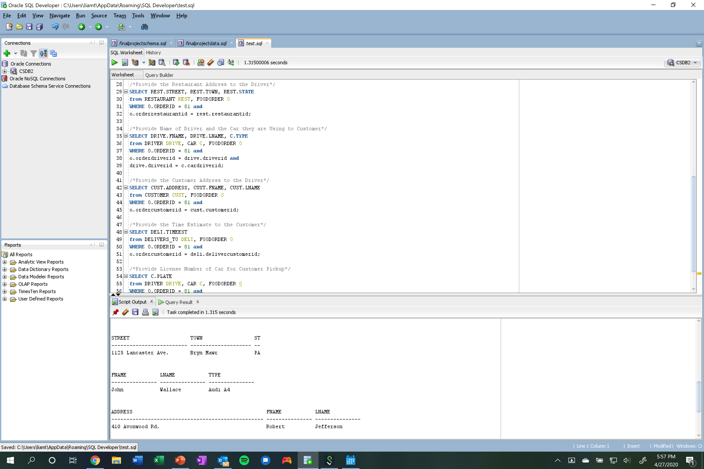
Sample Queries cont.
Get the restaurant’s address so driver can pick up order
Get driver name and the car they’re driving for the customer
Provide the customer address to the driver so they know where to drop off the order

Slide 17
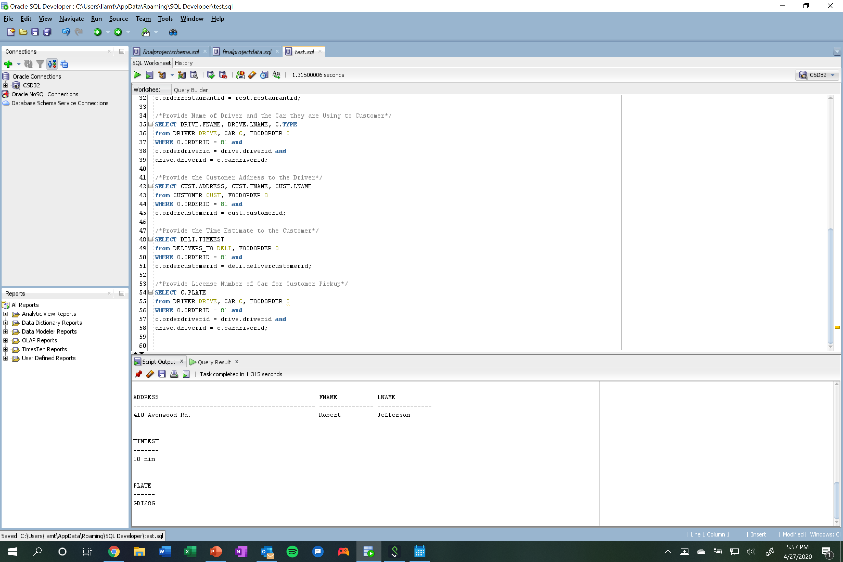
Sample Queries cont.
Provide estimated time the delivery will take
Get the license plate of the driver’s car for the customer so they can identify the car

Slide 18
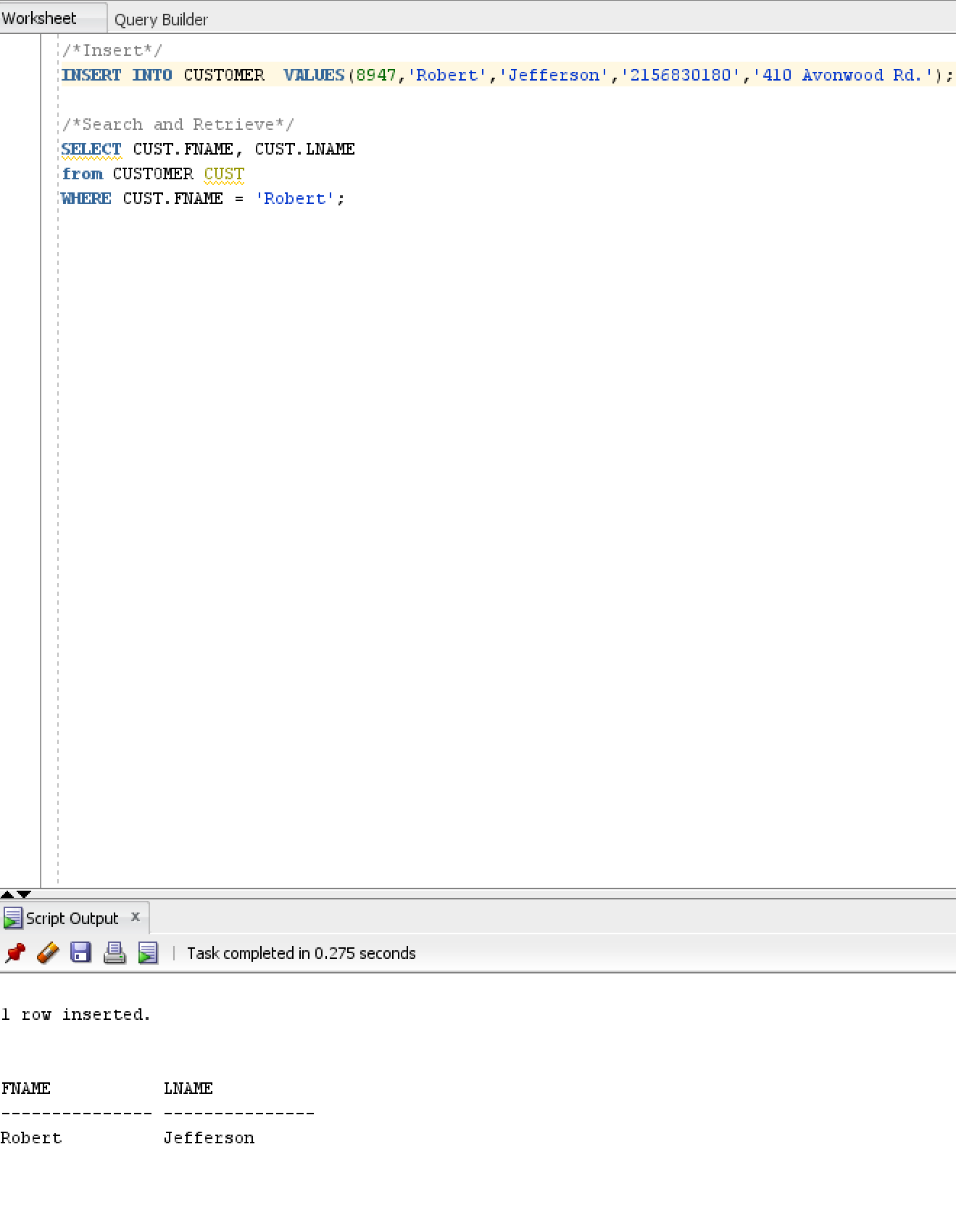
Functionality
Able to insert, search and retrieve records

Slide 19
Thank You for Watching!

